Slide 1
Gender Pay Gap in STEM
Notes:
In 2006, in an attempt at reducing gender inequalities in the workplace, Denmark passed a law, forcing all private companies over 35 employees to publicly disclose their gender pay gap. It was believed that transparency would make companies voluntarily reduce their gap, and they were right: studies found that the gender pay gap shrank by 7% compared to before the law was passed.
This is in this context, in this search for more transparency that I’m presenting you this groundbreaking study of the gender pay gap in STEM.

Slide 2
Introduction
Global Gender Pay Gap: 20%
Women make up for 28% of the workforce in STEM fields
Is gender an actual predictor of salary discrepancies, and to what extent?
Notes:
it is believed that women are paid 20% less than men, globally. Women continue to face significant challenges especially in STEM field where they remain significantly underrepresented (28% of the workforce), despite the ongoing efforts to make the fields more attractive for them.
This project therefore aimed at analyzing the gender pay gap in those fields and we will try to answer the following question: is gender, something that should not influence salary, an actual predictor of salary discrepancies, along with parameters that should influence salary (think years of experience, title, education, etc). With the help of a linear regression

Slide 3
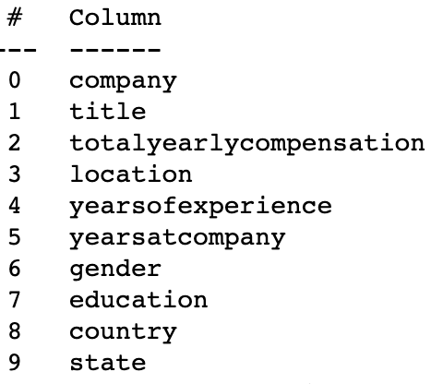
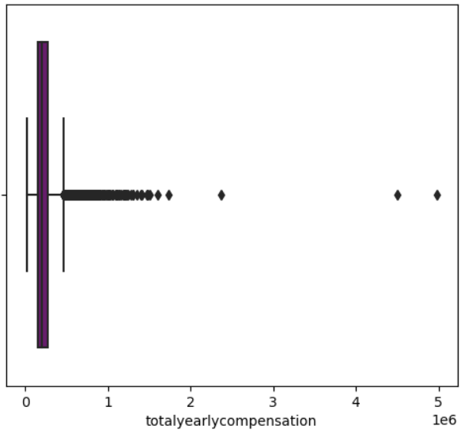
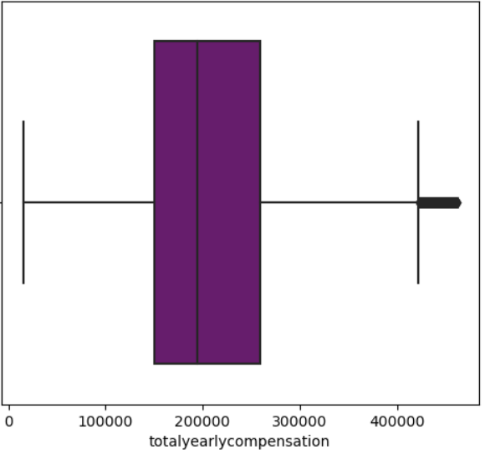
The Dataset: “Data Science and STEM salaries”
62,000+ salaries scraped from levels.fyi
After cleaning: 19,000+ entries
Company, Title, Total Yearly Compensation, Years of Experience, Years at the company, Gender, Education, State
Notes:
What do we think actually influence the salary? What to keep?
NaN in Gender
Total yearly compensation (base, bonus, stock) - remove outliers (paid 4 to 5 millions)
NaN in Education
Location (keep only the US)
Job Title (remove some that weren’t relevant like marketing, sales)

Slide 4
EDA -
Insights on women in STEM and their salaries

Slide 5
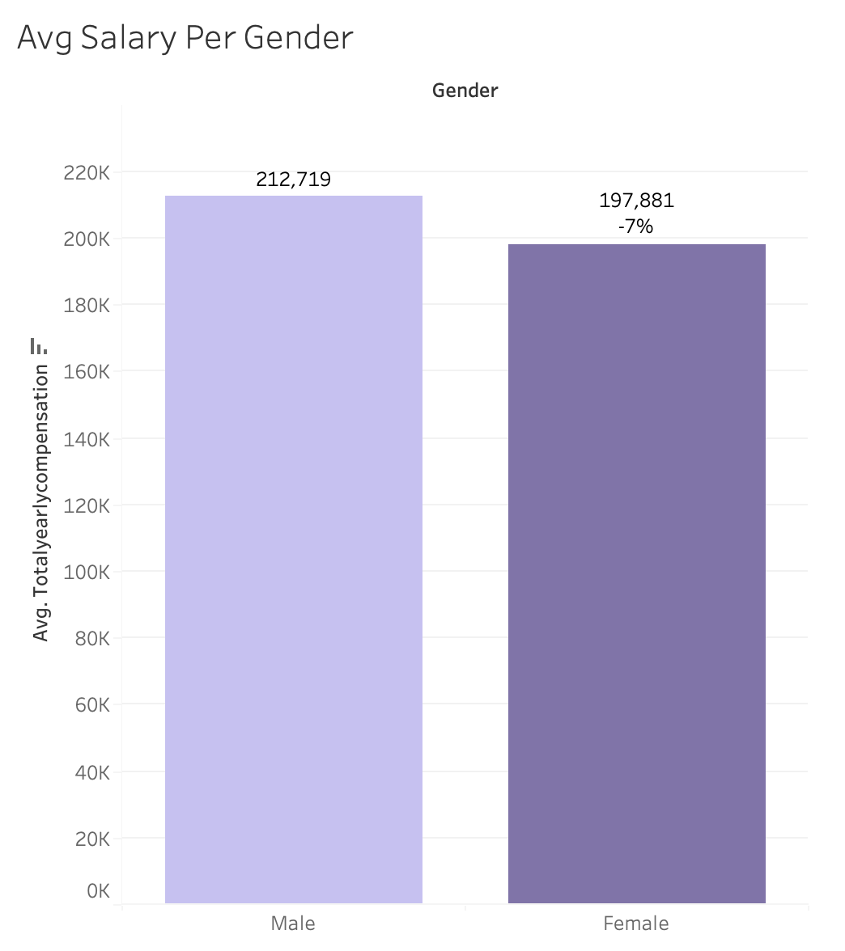
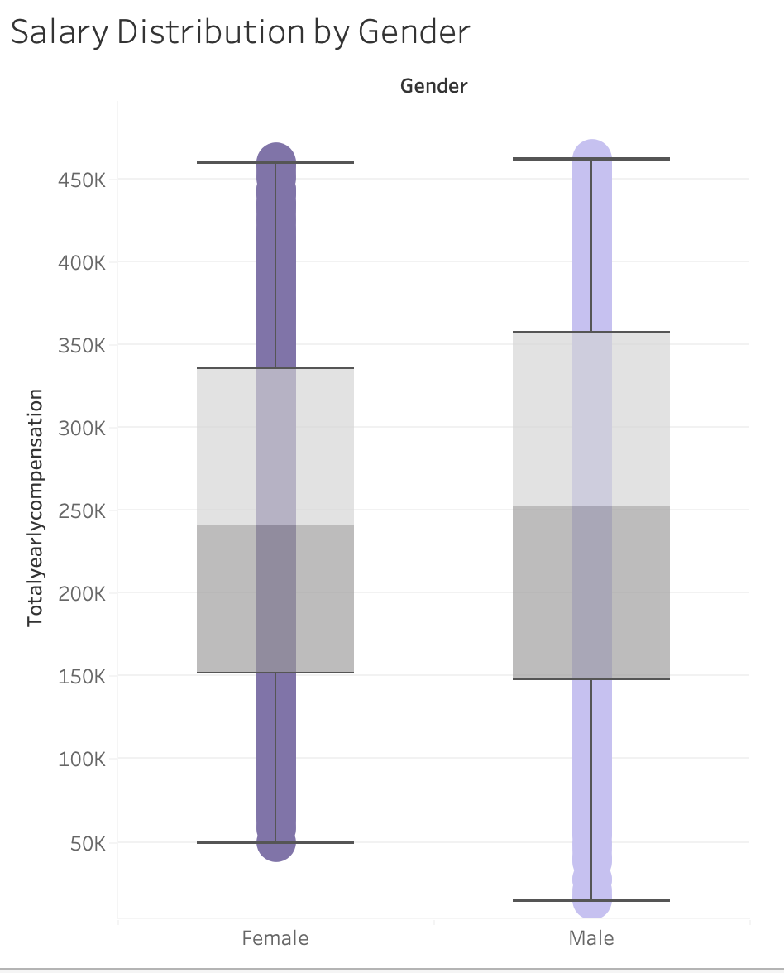
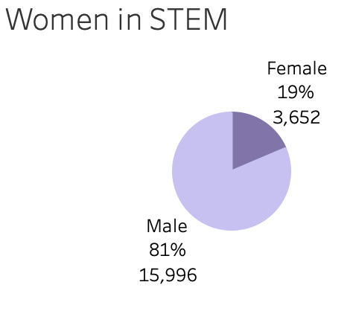
EDA -
Notes:
Women represent 19% of the workforce, which is less than that 28% official statistic.
Women are paid 7% less than men in average.
Despite a higher minimum score and lower quartile, the median salary for women is lower. The distribution is similar, with a very similar maximum score.

Slide 6
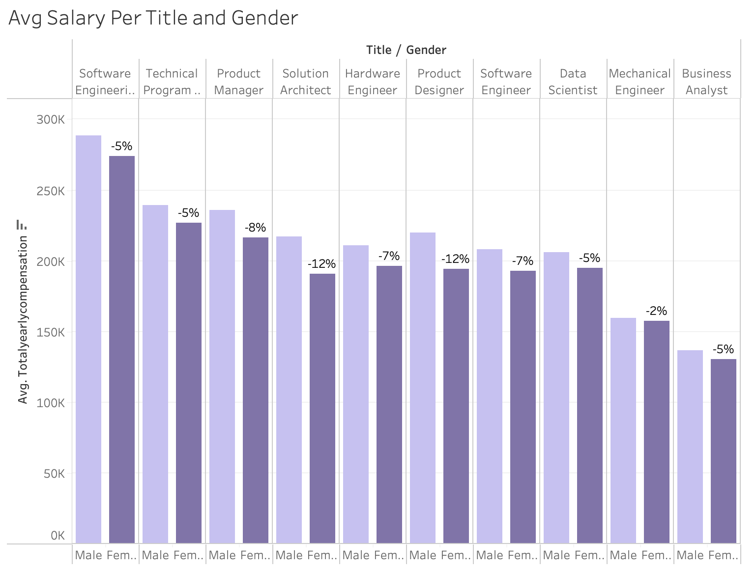
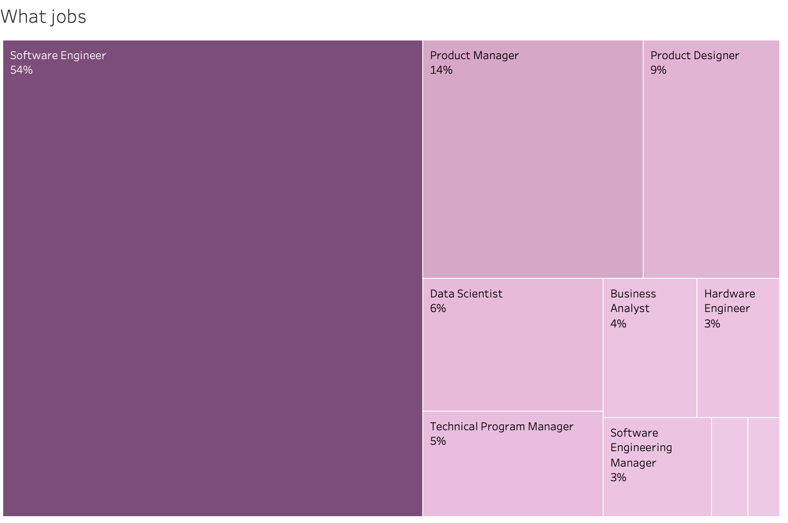
EDA
Notes:
Like men, women are mostly software engineers. They are however over represented in Product (Manager + Designer).
Salary, which varies between different job titles, is always lower for women than men.

Slide 7
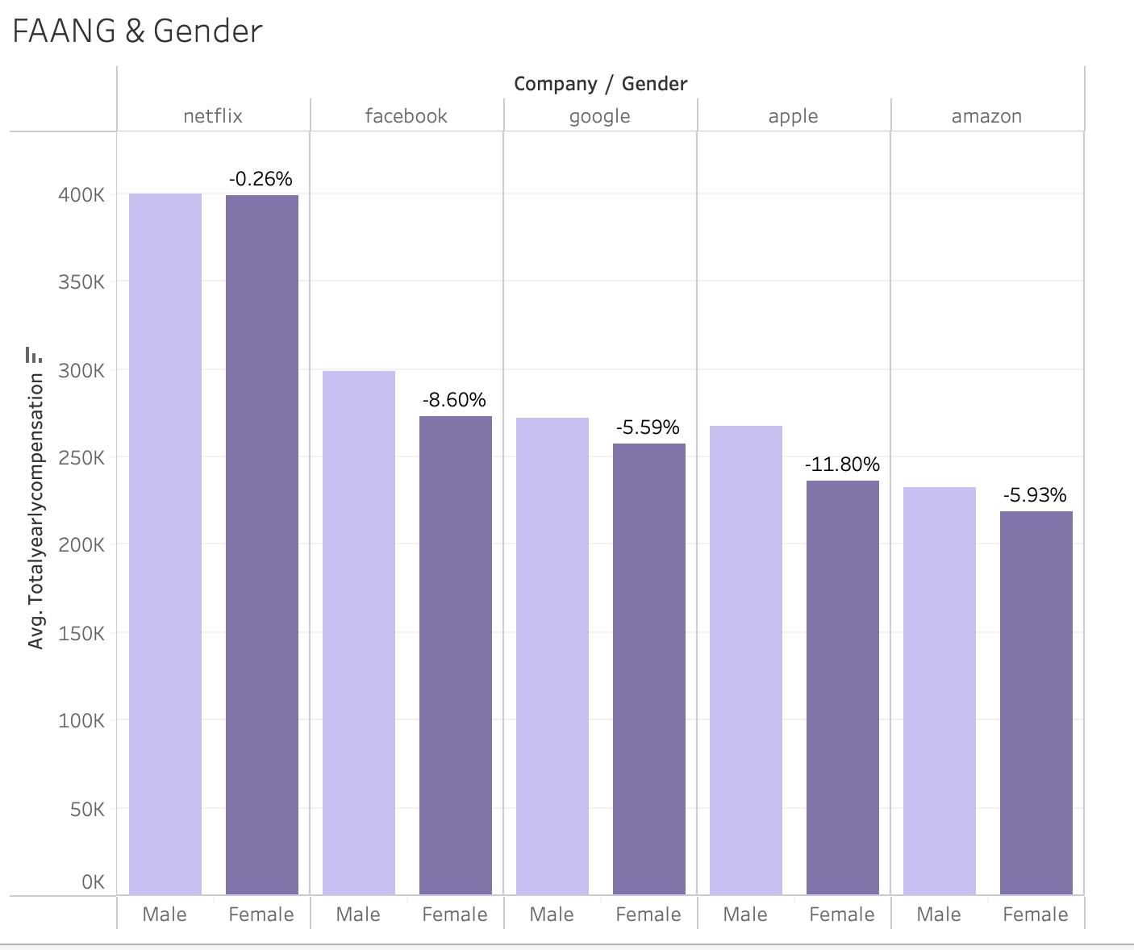
EDA
Notes:
FAANG
Apple has the biggest pay difference between genders.
Netflix, Google and Amazon has a gap smaller than in average.

Slide 8
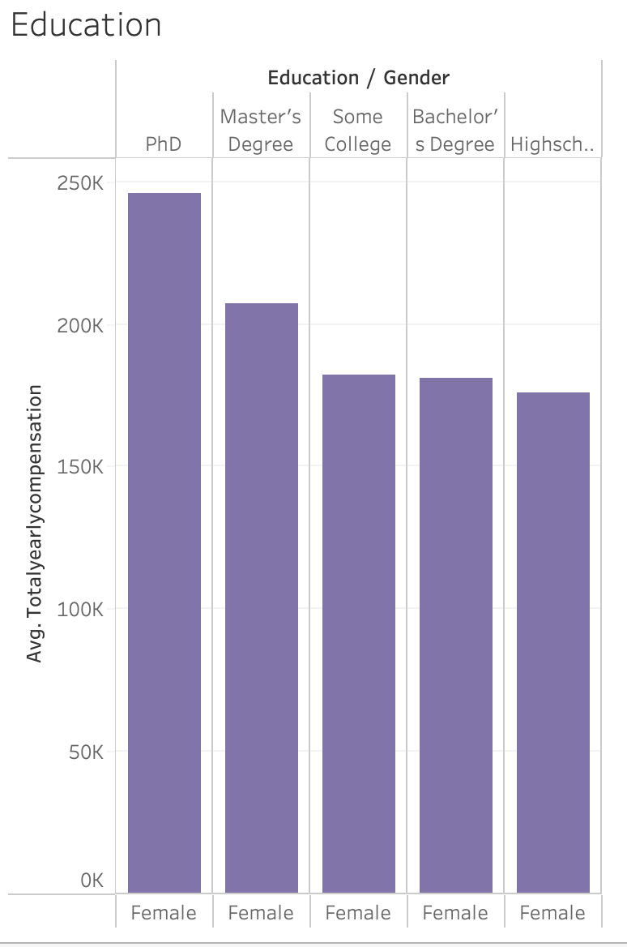
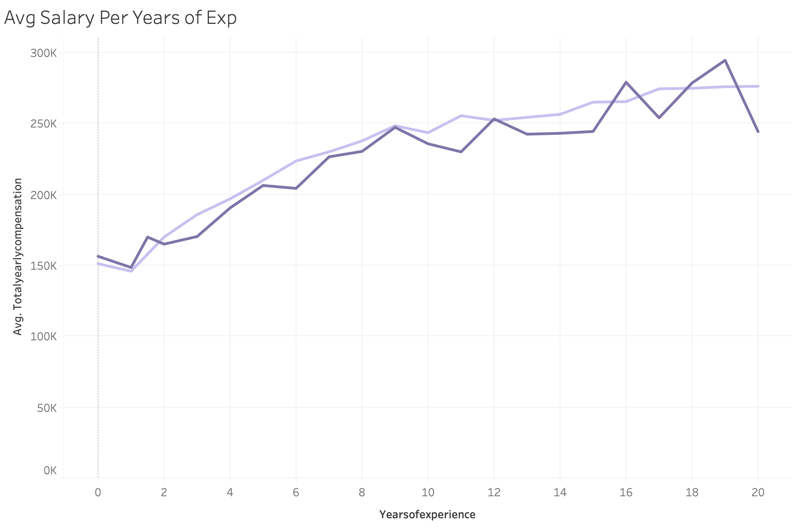
EDA
Notes:
Salary increases with level of diploma, as expected. Interestingly, having a bachelor didn’t seem to influence the avg salary, compared to some college.
Interestingly, women seem to have a higher avg salary at the beginning of their career, which might indicate positive change for women just recently entering the job market.

Slide 9
Linear Regression -
Is gender a predictor of salary in STEM jobs?

Slide 10
The model
Objective: measure the influence of gender on the yearly compensation
Dependant variable: total yearly compensation
Independent variables: gender, company (FAANG?), location (4 specific states), years of experience, years at the company, job title, education
Data Transformation for the model:
Added 2 columns: is_female and is_faang
Job Title and State were dummified, Education was one hot encoded
Total Yearly Compensation was log-transformed
Notes:
Gender was turned into a binary column (is female 1, male 0), as well as company (is faang 1)
States: first ran the model with all of them and realised that only some states seem to have statistical significance so kept California, NY, Washington, Massachusetts

Slide 11
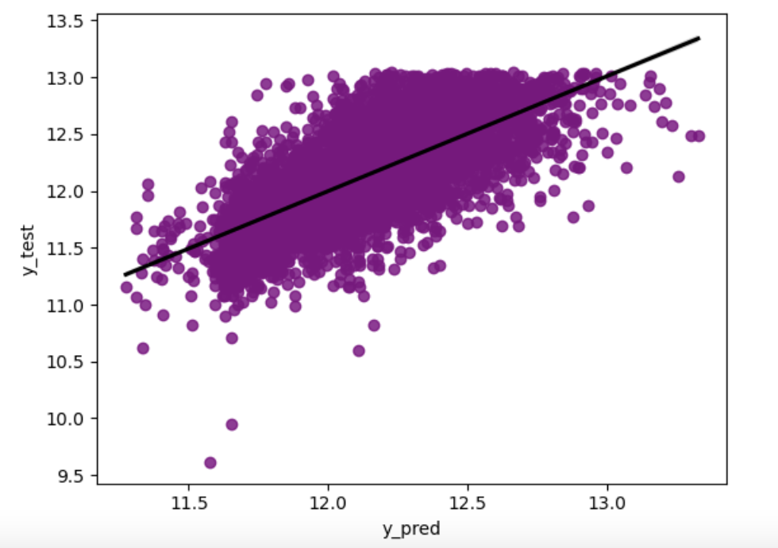
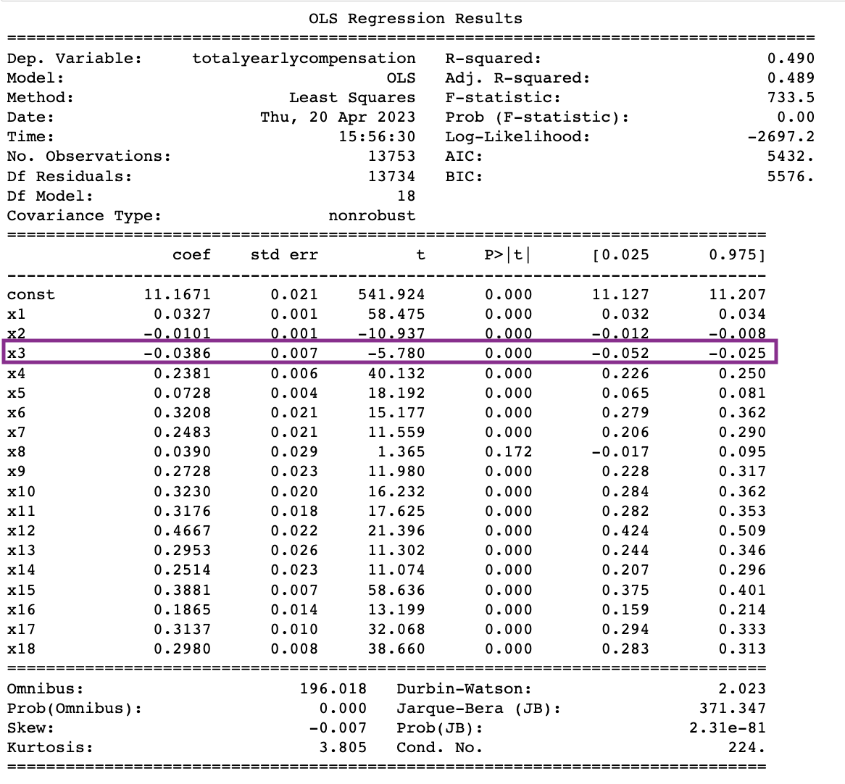
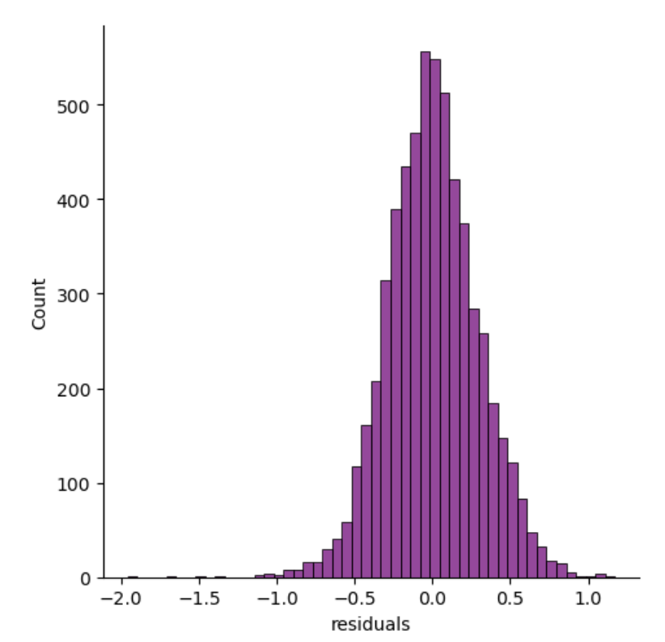
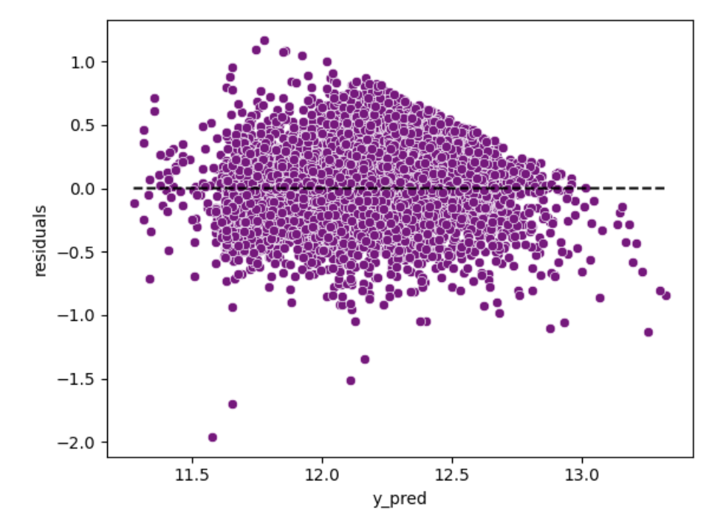
Linear Regression - Results
Notes:
R-Squared: 49% percent = (math.exp( -0.0386)-1)*100 = -3.8%
1 experience, 2 years at comp, 3 gender, 4 FAANg, 5 education, 6 data scientist, 7 hardware engineer, 8 mechanical engineer, 9 product designer, 10 product manager, 11, software engineer, 12 software engineer manager, 13, solution architect
14 technical program manager 15 california 16 massachusetts 17 new york 18 washington

Slide 12
Conclusion
Gender is a predictor of compensation
All else being equal, being a women working in STEM results in a 3.8% decrease in salary
Weak explanatory power of our model
Important predictors of salaries are missing (level, performance, negotiation skills, etc).
Disclosure is vital but further strong and strategic action is needed to address the underlying factors and really make a difference
Notes:
This project aimed to analyze the gender pay gap in STEM jobs using a simple linear regression model. The analysis revealed that gender is indeed a predictor of compensation in the STEM industry and that being a women in STEM results in a 3.8% decrease in salary.
However, the model had weak explanatory power, indicating that important predictors of salaries were missing from the dataset. Factors such as job level, performance, negotiation skills, likely play a significant role in determining compensation, but were not included in the analysis.
Despite these limitations, the finding that being a women is associated with lower compensation highlights the need for continued efforts to promote greater gender diversity and equality in the STEM industry.
Moving forward, we however can’t stop at disclosure: while it is one simple and necessary step for exposing inequalities, strong and strategic action is needed to really make a difference and have women paid the same as their male counterparts.
Exemple of denmark: was achieved primarily by slowing the wage growth for males, while there were no significant differences in female wage growth.

